Slide 1

Stakeholder-developer communication
Adam Karl

Slide 2
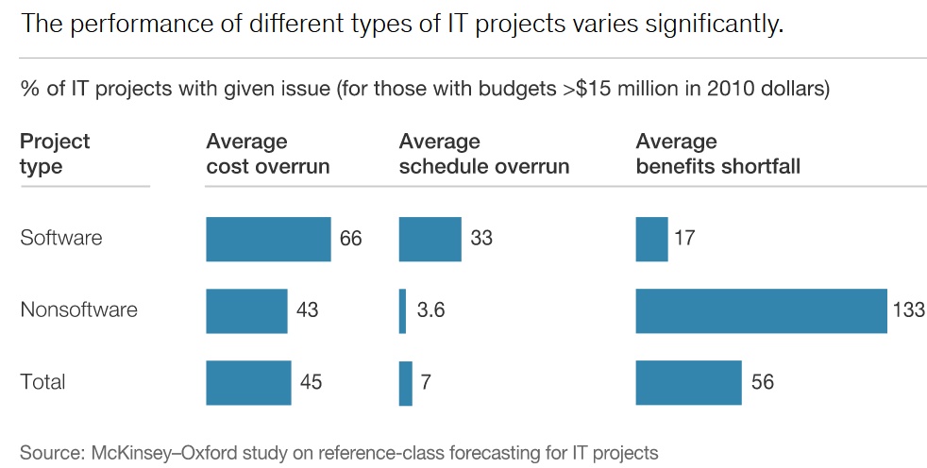
The Problem
Software development regularly runs over budget and fails to meet deadlines
17% of large projects threaten the very existence of the company
“black sheep” projects

Slide 3
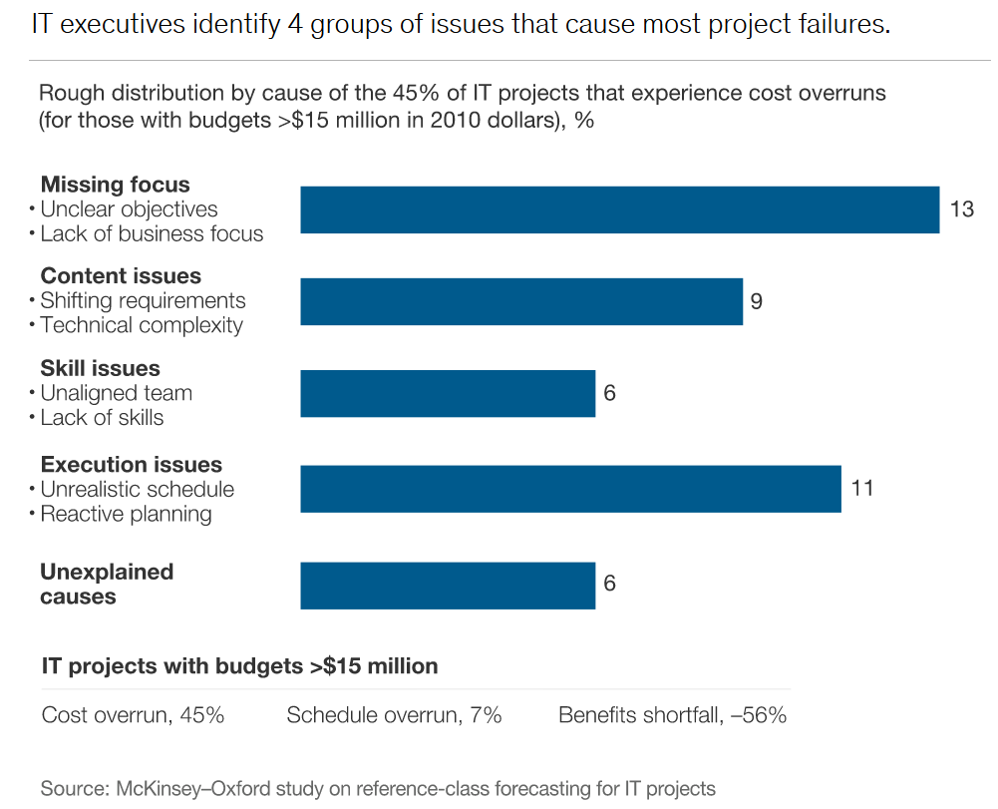
Leading issues
Unclear or shifting requirements
Poor scheduling
Technical complexity

Slide 4
Solution
Minimize any disappointments of software development by targeting better communication from both stakeholders and developers at the initial negotiations.

Slide 5
Definition of Terms
Stakeholder
Developer
Anyone who:
Doesn’t have technical knowledge
Has financial investment in the project
Anyone who:
Has technical training
Part of the development team

Slide 6
Project Requirements
What will the development cycle look like?
Will there be ongoing development?
What are the most important features of the project?
Be as specific as possible
How essential is each feature?
Can this wait until after the project is deployed?

Slide 7
Good vs Bad Product descriptions
Bad
Good
“…like [Netflix] but for X.”
“Suggest similar items to the user”
Bad product descriptions are too common in the industry
“The top priority is to help our employees do [X] easier”
“Our clients will mainly use this to X”
“These are the features that should be easily accessible:”
The more specific, the better

Slide 8
Questions to improve poor descriptions
“What specifically about Netflix/Spotify/[other app] do you like?”
The content?
The interface?
How many users are expected for this product?
i.e. the scope of the project
What kind of development will be done after launch?

Slide 9
Develop a shared language
Stakeholders might vaguely use a term that has specific, technical meaning to the developers
Stakeholders might use buzzwords incorrectly, confusing the developers
Actor
Object
Program
App
Browser
Network

Slide 10
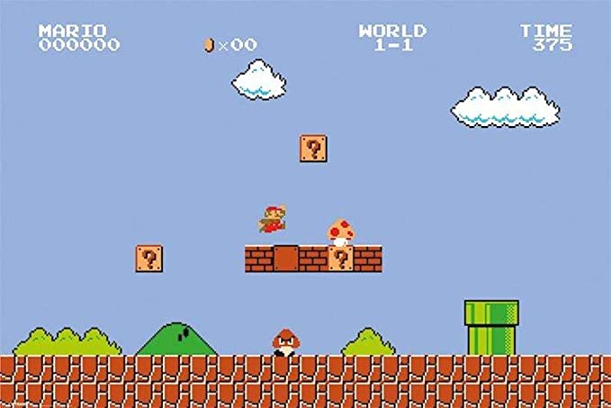

Slide 11
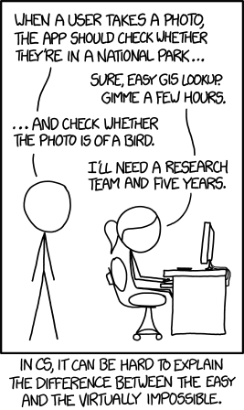
Computational Complexity
Stakeholders can often have misconceptions about what they’re asking for
It’s important to maintain a respectful level of communication

Slide 12
Development Time
It’s impossible to predict the amount of time that development will take
Developers should emphasize that no development team will be able to guarantee delivery by a tight deadline
Foster reasonable expectations
Optimism bias: when someone believes that they themselves are less likely to experience a negative event
…there are some ways to help combat this…

Slide 13
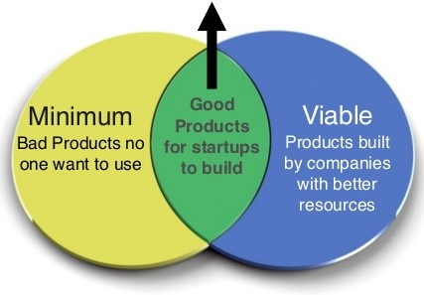
Minimum Viable Product
Decide on the minimum features to include
Decide on the minimum acceptable quality of each feature
From completion, the stakeholders will be in the best position to strategize/prioritize further investment
Minimum Viable Products often have a negative connotation…

Slide 14
Conclusion
Better communication during the negotiations phase will lead to more focused, productive development
A precisely defined minimum viable product leaves little to the imagination of the developers
It will also manage the stakeholders expectations for a more realistic development cycle

Slide 15
Contact Information
Adam Karl: akk67@pitt.edu

Slide 16
References
Bloch, M., Blumberg, S., & Laartz, J. (2020, February 13). Delivering large-scale IT projects on time, on budget, and on value. Retrieved March 13, 2021, from https://www.mckinsey.com/business-functions/mckinsey-digital/our- insights/delivering- large-scale-it-projects-on-time-on-budget-and-on-value

